Slide 1
MENUS
UNIT II

Slide 2
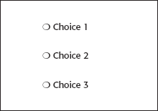
STRUCTURE OF MENUS:
Single Menu:
Simplest form of menu.
Single screen or window is presented to get the user’s input or request an action to be performed.
Single menu may be iterative if it requires data to be entered and then subject to validity check. If check fails, the menu will represent the user with a message requesting to re-entry valid data.

Slide 3
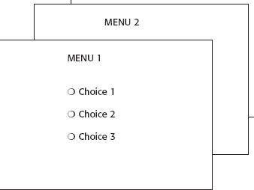
Sequential Linear Menus:
Sequential linear menus are presented on a series of screens possessing only one path.
The menu screens are presented in a predefined order and generally, their objective is for specifying parameters for entering data.
A long sequence may become tedious as menu after menu is presented.

Slide 4
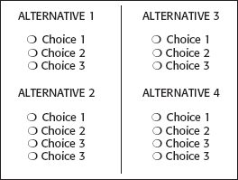
Simultaneous Menu:
Instead of being presented on separate screens, all menu options are available simultaneously.
The menu may be completed in the order desired by the user, choices being skipped and returned to later.
Problems with simultaneous menus are
For large collections of menu alternatives causes screen clutter easily.
Also be very confusing.

Slide 5
Hierarchical Menus:
A hierarchical structure results in an increasing refinement of choice as menus are stepped through
For example, from options to sub-options, from categories to subcategories, from pages to sections to subsections and so on.
A hierarchical structure can best be represented as an inverse tree, leading to more and more branches as one moves downward through it.
Common examples of hierarchical design today are found in menu bars with their associated pull-downs.

Slide 6
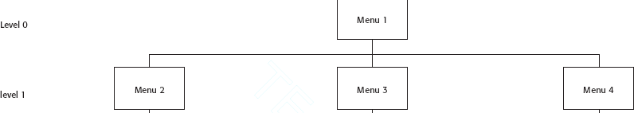
A disadvantage of a hierarchical scheme is that the defined branching order may not fit the users conception of the task flow.
If users are not familiar with the hierarchical menu, they are unable to predict what sub-options lie below.
A particular choice, they may go down wrong paths and find it necessary to go back up the tree to change a choice, or perhaps even return to the top-level menu.

Slide 7
Connected Menus
Connected menus are networks of menus all interconnected in some manner.
Movement through a structure of menus is not restricted to a hierarchical tree, but is permitted between most or all menus in the network.
A connected menu system may be
cyclical with movement permitted in either direction between menus or
acyclical with movement permitted in only one direction.
These menus also vary in connectivity, the extent to which menus are linked by multiple paths.

Slide 8
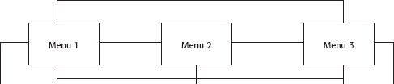
Advantage: It gives the full control over the navigation flow to user.
Disadvantage: Complexity.
Event-Trapping Menus:
Event Trapping menus provide an ever-present background of control over the system’s state and parameter while the user working on foreground task.

Slide 9
Set of simultaneous menus imposed on hierarchical menus.
These menus can also content based upon the system state or event existing at that moment.
For example, a paste option in word processing application will only function if there is something in a clipboard to paste.

Slide 10
FUNCTIONS OF MENUS:
A menu can be used to perform several functions
to navigate to a new menu
to execute an action or procedure
to display information or
to specify input data or parameters

Slide 11
Navigation to a New Menu:
Each user selection causes another menu in a hierarchical menu tree to be displayed.
The purpose of each selection is to steer the user toward an objective or goal.
Selection errors may lead the user down wrong paths, and cost time and, perhaps, aggravation, but these errors are non-destructive and usually undoable.

Slide 12
Execute an Action or Procedure:
A user selection directs the computer to implement an action or perform a procedure.
The action may be something like opening or closing a file, copying text or sending a message.
Selection errors may or may not have serious consequences depending upon the nature of the action.
Accidental selection of critical irreversible actions must be prevented in interface design.

Slide 13
Displaying Information:
The main purpose of selecting a menu choice may simply be to display information.
The user may be searching for specific information in a database or browsing the Web.
The user’s focus is primarily on the information desired and less on the selection function.
The content material and the user’s interests will determine the paths followed.
Wrong turns in the process will again cost time and perhaps aggravation, but these errors are non-destructive and usually undoable.

Slide 14
Data or Parameter Input:
Each selection specifies a piece of input data for the system or provides a parameter value.
Data or values may be input on a single menu or spread over a hierarchy of menus.
The user’s focus is primarily on the information being provided and less on the selection function.
Selection errors can easily be corrected if detected by the system.

Slide 15
CONTENT OF MENUS:
A menu consists of four elements,
its context,
its title,
its choice descriptions and
its completion instructions.

Slide 16
Menu Context:
A menu’s context provides information to keep the user oriented.
Feedback is necessary that tells users where they are in a process, what their past choices were, and possibly how much farther they still have to navigate.
Verbal linkage, spatial linkage, or both may be used to provide navigation feedback.
Verbal linkage involves providing, on the current menu screen, a listing of choices made on previous menus that have led to this position. It also involves assuring the user that the displayed menu is the menu desired.
Spatial linkage can be accomplished by graphic methods. Each succeeding menu screen can be displayed overlapping the previous menu screen so a succession of choices can be seen in a single view.

Slide 17
Menu Title:
A menu’s title provides the context for the current set of choices.
The title must reflect the choice selected on the previously displayed menu.
Choice Descriptions:
Choice descriptions are the alternatives available to the user.
These descriptions can range from a mnemonic, numeric, or alphabetized listing of choices to single words or phrases to full sentences or more.

Slide 18
Completion Instructions:
Completion instructions tell users how to indicate their choices.
They may include why the user is being asked to make this choice and the impact the choice will have on sunsequent processes.
Explicit instructions may be needed for first time or casual users of a system.
Experienced users will find overly verbose instructions unnecessary.
The needs of all system users, and the nature of the system, must again be considered in creating this kind of on-screen guidance.

Slide 19
FORMATTING OF MENUS:
The human-computer interface has a history of experimental studies with menus.
The results of which can be applied to graphical screen and web page menu design and presentation.
Which follows a series of guidelines for formatting menus.

Slide 20
Consistency:
Provide consistency with the user’s expectations.
Provide consistency in menu
Formatting including organization, presentation, and choice ordering.
Phrasing including titles, choice descriptions, and instructions.
Choice selection methods.
Navigation schemes.

Slide 21
Display:
If continual or frequent references to menu options are necessary, permanently display the menu in an area of the screen that will not obscure other screen data.
If only occasional references to menu options are necessary, the menu may be presented on demand.
Whether to display menu continually or on demand is determined by the menu’s frequency of use.
Always permanently display menus that are frequently referenced.

Slide 22
Presentation:
Ensure that a menu and its choices are obvious to the user by presenting them with a unique and consistent structure, location, and/or display technique.
A menu and its choices should be immediately recognizable by the user as being a menu of choices.
Ensure that other system components do not possess the same visual qualities as menu choices.

Slide 23
Organization:
Provide a general or main menu.
Display:
All relevant alternatives.
Only relevant alternatives.
Delete or gray-out inactive choices.
Match the menu structure to the structure of the task.
Organization should reflect the most efficient sequence of steps to accomplish a person’s most frequent or most likely goals.
Minimize number of menu levels within limits of clarity.
For Web sites, restrict it to two levels (requiring two mouse clicks) for fastest performance.

Slide 24
Be conservative in the number of menu choices presented on a screen:
Without logical groupings of elements, limit choices to 4 to 8.
With logical groupings of elements, limit choices to 18 to 24.
Provide decreasing direction menus, if sensible.
Never require menus to be scrolled.
Provide users with an easy way to restructure a menu according to how work is accomplished.

Slide 25
Complexity:
Provide both simple and complex menus.
Simple: a minimal set of actions and menus.
Complex: a complete set of actions and menus.
Providing two set of menus will more effectively satisfy the differing needs of the casual and expert user.

Slide 26
Item Arrangement
Align alternatives or choices into single columns whenever possible.
Orient for top-to-bottom reading.
Left-justify descriptions.
If a horizontal orientation of descriptions must be maintained:
Organize for left-to-right reading.

Slide 27
Ordering:
Order lists of choices by their natural order.
For lists associated with numbers, use numeric order.
For textual lists with a small number of options (seven or less), order by:
Sequence of occurrence.
Frequency of occurrence.
Importance.
Semantic similarity.
Use alphabetic order for:
Long lists (eight or more options).
Short lists with no obvious pattern or frequency.

Slide 28
Separate potentially destructive actions from frequently chosen items.
If option usage changes, do not reorder menus.
Maintain a consistent ordering of options on all related menus.
For variable-length menus, maintain consistent relative positions.
For fixed-length menus, maintain consistent absolute positions.

Slide 29
Groupings:
Create groupings of items that are logical, distinctive, meaningful, and mutually exclusive.
Categorize them in such a way as to:
Maximize the similarity of items within a category.
Minimize the similarity of items across categories.
Present no more than six or seven groupings on a screen.
Order categorized groupings in a meaningful way.

Slide 30
If meaningful categories cannot be developed and more than eight options must be displayed on a screen, create arbitrary visual groupings that:
Consist of about four or five but never more than seven options.
Are of equal size.
Separate groupings created through either:
Wider spacing, or
A thin ruled line.
Provide immediate access to critical or frequently chosen items.

Slide 31
Line Separators
Separate vertically arrayed groupings with subtle solid lines.
Separate vertically arrayed subgroupings with subtle dotted or dashed lines.
For subgroupings within a category:
Left-justify the lines under the first letter of the columnized choice descriptions.
Right-justify the lines under the last character of the longest choice description.
For independent groupings:
Extend the line to the left and right menu borders.

Slide 32
PHRASING THE MENU:
A menu must communicate to the user information about:
The nature and purpose of the menu itself.
The nature and purpose of each presented choice.
How the proper choice or choices may be selected.

Slide 33
Menu Titles
Main menu:
Create a short, simple, clear, and distinctive title, describing the purpose of the entire series of choices.
Submenus:
Submenu titles must be worded exactly the same as the menu choice previously selected to display them.
General:
Locate the title at the top of the listing of choices.
Spell out the title fully using either an:
Uppercase font.
Mixed-case font in the headline style.
Superfluous titles may be omitted.

Slide 34
Menu Choice Descriptions :
Create meaningful choice descriptions that are familiar, fully spelled out, concise and distinctive.
Descriptions may be single words, compound words, or multiple words or phrases.
Exception: Menu bar items should be a single word (if possible).
Place the keyword first, usually a verb.
Use the headline style, capitalizing the first letter of each significant word in the choice description.
Use task-oriented not data-oriented wording.

Slide 35
Use parallel construction.
A menu choice must never have the same wording as its menu title.
Identical choices on different menus should be worded identically.
Choices should not be numbered.
Exception: If the listing is numeric in nature, graphic, or a list of varying items, it may be numbered.
Word choices as commands to the computer.

Slide 36
Menu Instructions
For novice or inexperienced users, provide menu completion instructions.
Place the instructions in a position just preceding the part or parts of the menu to which they apply.
Left-justify the instruction and indent the related menu choice descriptions a minimum of three spaces to the right.
Leave a space line, if possible, between the instructions and the related menu choice descriptions.
Present instructions in a mixed-case font in sentence style.
For expert users, make these instructions easy to ignore by:
Presenting them in a consistent location.
Displaying them in a unique type style and/or color.

Slide 37
Intent Indicators
Cascade indicator:
To indicate that selection of an item will lead to a submenu, place a triangle or right-pointing solid arrow following the choice.
A cascade indicator must designate every cascaded menu.
To a window indicator:
For choices that result in displaying a window to collect more information, place an ellipsis (. . .) immediately following the choice.
Exceptions—do not use when an action:
Causes a warning window to be displayed.
May or may not lead to a window.
Direct action items:
For choices that directly perform an action, no special indicator should be placed on the menu.

Slide 38
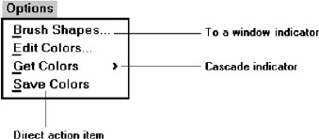
Keyboard Equivalents
To facilitate keyboard selection of a menu choice, each menu item should be assigned a keyboard equivalent mnemonic.

Slide 39
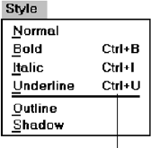
The mnemonic should be the first character of the menu item’s description.
If duplication exists in first characters, use another character in the duplicated item’s description.
Preferably choose the first succeeding consonant.
Designate the mnemonic character by underlining it.
Use industry-standard keyboard access equivalents when they exist.

Slide 40
Keyboard Accelerators :
For frequently used items, provide a keyboard accelerator to facilitate keyboard selection.
The accelerator may be one function key or a combination of keys.
Function key shortcuts are easier to learn than modifier plus letter shortcuts.
Pressing no more than two keys simultaneously is preferred.
Do not exceed three simultaneous keystrokes.
Use a plus (+) sign to indicate that two or more keys must be pressed at the same time.
Separate the accelerator from the item description by three spaces.
Right-align the key descriptions.

Slide 41
Do not use accelerators for:
Menu items that have cascaded menus.
Pop-up menus.

Slide 42
SELECTING MENU CHOICES:
Initial Cursor Positioning
If one option has a significantly higher probability of selection, position the cursor at that option.
If repeating the previously selected option has the highest probability of occurrence, position the cursor at this option.
If no option has a significantly higher probability of selection, position the cursor at the first option.

Slide 43
Choice Selection:
Pointers:
Select the choice by directly pointing at it with a mechanical device such as a mouse or trackball pointer, or light pen, or pointing with one’s finger.
If pointing with a mechanical device is the selection method used:
The selectable target area should be at least twice the size of the active area of the pointing device or displayed pointer. In no case should it be less than 6 millimeters square.
Adequate separation must be provided between adjacent target areas.
If finger pointing is the selection method used:
The touch area must be a minimum of 20 to 30 millimeters square.
The touch area must encompass the entire caption plus one character around it.

Slide 44
Keyboard:
If moving the cursor to a menu choice:
The up and down arrow keys should move the cursor up or down vertically oriented menu options.
The left and right cursor keys should move the cursor left or right between horizontally oriented menu options.
If keying a choice identifier value within an entry field:
Locate the entry field at the bottom of the last choice in the array of choices.
Uppercase, lowercase, and mixed -case typed entries should all be acceptable.

Slide 45
Selection/execution:
Provide separate actions for selecting and executing menu options.
Indicate the selected choice through either:
Highlighting it with a distinctive display technique.
Modifying the shape of the cursor.
Permit unselecting choice before execution.
If a menu is multiple choice, permit all options to be selected before execution.
Combining techniques:
Permit alternative selection techniques, to provide flexibility.

Slide 46
Defaults:
Provide a default whenever possible.
Display as bold text.
Unavailable Choices:
Unavailable choices should be dimmed or “grayed out.”
Do not add or remove items from a menu unless the user takes explicit action to add or remove them through the application.

Slide 47
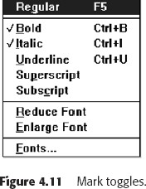
Mark Toggles or Settings:
Purpose:
Use to designate that an item or feature is active or inactive over a relatively long period of time.
Use to provide a reminder that an item or feature is active or inactive.
Guidelines:
Position the indicator directly to the left of the option.

Slide 48
Toggled Menu Items
Purpose:
Use to designate two opposite commands that are accessed frequently.
Use when the menu item displayed will clearly indicate that the opposite condition currently exists.
Guidelines:
Provide a meaningful, fully spelled-out description of the action.
Begin with a verb that unambiguously represents the outcome of the command.
Use mixed-case letters, with the first letter of each word capitalized.

Slide 49
KINDS OF GRAPHICAL MENUS:
Menu Bar:
Proper usage:
To identify and provide access to common and frequently used application actions that takes place in a wide variety of different windows.
A menu bar choice by itself should not initiate an action.
The advantages of menu bars are that they:
Are always visible, reminding the user of their existence.
Are easy to browse through.
Are easy to locate consistently on the screen.
Allow for use of keyboard equivalents

Slide 50
The disadvantages of menu bars are that:
They consume a full row of screen space.
They require looking away from the main working area to find.
They require moving pointer from the main working area to select.
The menu options are smaller than full-size buttons, slowing selection time.
Their horizontal orientation is less efficient for scanning.
Their horizontal orientation limits number of choices that can be displayed

Slide 51
2. Pull-Down Menu
Proper usage:
To initiate frequently used application actions that take place on a wide variety of different windows.
A small number of items.
Items best represented textually.
Items whose content rarely changes.
The advantages of pull-down menus are:
They may be located relatively consistently on the screen.
No window space is consumed when they are not used.
They are easy to browse through.
Their vertical orientation is most efficient for scanning and grouping.

Slide 52
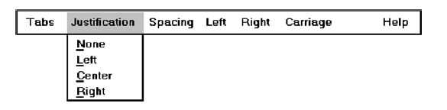
Their vertical orientation permits more choices to be displayed.
They allow for display of both keyboard equivalents and accelerators.
The disadvantages of pull-down menus are:
They require searching and selecting from another menu before seeing options.
They require looking away from main working area to read.
The require moving the pointer out of working area to select (unless using keyboard equivalents).
The items are smaller than full-size buttons, slowing selection time.

Slide 53
3. Cascading Menus:
Proper usage:
To reduce the number of choices presented together for selection (reduce menu breadth).
When a choice leads to a short, fixed list of single-choice properties.
To simplify a higher-level menu.
Avoid using for frequent, repetitive commands.
The advantages of cascading menus are that:
The top-level menus are simplified because some choices are hidden.
High-level command browsing is easier because subtopics are hidden.
The disadvantages of cascading menus are:
Access to submenu items requires more steps.

Slide 54
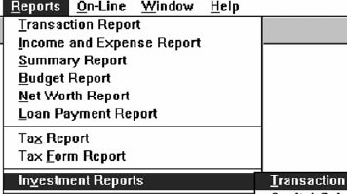
4. Pop-up Menus
Use to present alternatives or choices within the context of the task.
The advantages of pop-up menus are:
They appear in the working area.
They do not use window space when not displayed.
No pointer movement is needed if selected by button.

Slide 55
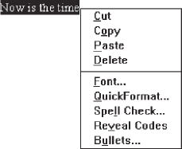
The disadvantages of pop-up menus are:
Their existence must be learned and remembered.
They require a special action to see the menu (mouse click).
Items are smaller than full-size buttons, slowing selection time.
Their display locations may not be consistent.

Slide 56
5. Tear-off Menus
It may also be called a pushpin, detachable, or roll-up menu.
Its purpose is to present alternatives or choices to the user that are frequently used and rarely changing in content.
Follow all relevant guidelines for pull-down menus.
Advantages/disadvantages.
No space is consumed on the screen when the menu is not needed.
When needed, it can remain continuously displayed.

Slide 57

6. Iconic Menus:
Use to remind users of the functions, commands, attributes, or application choices available.
Create icons that:
Help enhance recognition and hasten option selection.
Are concrete and meaningful.
Clearly represent choices

Slide 58
Advantages/disadvantages:
Pictures help facilitate memory of applications, and their larger size increases speed of selection.
Pictures consume considerably more screen space than text, and they are difficult to organize for scanning efficiency.
To create meaningful icons requires special skills and an extended amount of time.
Iconic menus should be used to designate applications or special functions within an application.
Icons must be meaningful and clear. They should help enhance recognition and hasten option selection.

Slide 59
NAVIGATION AND SELECTION:
General:
Permit multiple methods for selecting commands.
Keyboard equivalents:
Assign a mnemonic for each command.
A mnemonic should be as meaningful as possible. Use:
The first letter of the command, or if duplications exist,
The first letter of another word in the command, or
Another significant consonant in the command.
For standard commands, use mnemonics provided by the tool set.
Keyboard accelerators:
Assign keyboard accelerators for frequently used commands.
For standard commands, use keyboard accelerators provided by the tool set.

